Slide 1

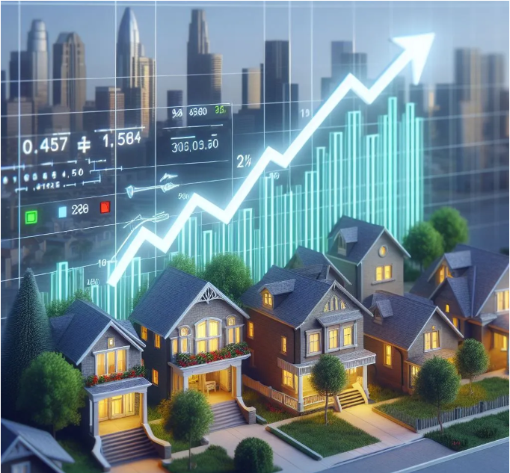
Course:Tools & Techniques for Data Science Course instructor:Dr.Syed Muhammad Usman Bukhari It's Machine Learning course in which we learn how to apply different approaches for better solution of real world problems one of them is houses price predictions during property dealings according to the luxuries in house/property. Project:ML Approach for UK Houses Price Prediction
Group Members Syed Ali Raza Shah Sana Saeed Maham Maryam

Slide 2
Problem Framing:
We want:
ML model analyze historical housing data and market trends.
Predict houses price for city of UK.
And consider the features like lot depth, community, washrooms, total parking spaces, sqft, lot front, sold price, type, kitchens plus, style, rooms plus, rooms, garage spaces, parking spaces.
And want to get an output of list price,which will help us in providing a reliable estimate of property.
Moreover,this work will make life easier for property owners/dealers and help them in their decision making.

Slide 3
Ideal Outcome:
Output will look like single numerical value as it will be a list price of house.
It will help property dealers in decision making.
Will help in making accurate estimates for each property.
Success Metric Positive feedback from users about accurate houses price prediction and reliability.
Failure Metric User finds the system unreliable or unhelpful for decision making.

Slide 4



Data Description:
Data Sources:
Dataset provided by MVSol Smart Realtors.
Key Attributes:
lot depth, community, washrooms, total parking spaces, sqft, lot front, sold price, type, kitchens plus, style, rooms plus, rooms, garage spaces, parking spaces.
Data Collection:
Data is likely aggregated and curated by MVSol Smart Realtors using real estate market data.

Slide 5
Available Areas
In raw dataset we have many cities like: Toronto,Peel,Simcoe,York,Durham,Dufferin,Muskoka,Grey county,Niagara,Halton,Wellington,Peterborough,Middlesex,canada,Kawarta lakes,Leeds & Grenvi,Brantford,Ottawa,Elgin,Hastings,Waterloo,Nipissing. Its just that areas which we just collect from 0nly 500 rows. The city which we had used for final analysis was Toronto and it has following areas: Bendale,Niagara,South Riverdale,Malvern,Annex,Waterfront Communities C1,Mimico,Other,Rosedale-Moore Park,Mount Olive-Silverstone-Jamestown,L'Amoreaux,Willowdale West,Willowdale East,West Humber-Clairville,Church-Yonge Corridor,Islington-City Centre West,Mount Pleasant West,Agincourt South-Malvern West,Bay Street Corridor,Flemingdon Park,Woburn,Bayview Village,Newtonbrook East,Banbury-Don Mills,Dorset Park, Moss Park.

Slide 6
INDUSTRIAL BUILDINGS
Data Preprocessing: Data Cleaning: Prior we collect a huge dataset with Number of rows: 125070 & Number of columns: 368 from MVSol Smart Realtors which have lot of null values then we had selected that features which company was already using for price prediction manually and it contains lot of cities from which we selected Toronto city as per company instructions.Firstly this huge data set collection take a huge time in downloading,as it was huge we downloaded it in chunks and then combine this data using SQL. Transformations: Then we check numeric and string features and convert those string features into numeric features and remove those extra features which were not used manually by reducing this data we get 25 features then we normalized the values and use KNN imputer method for imputation of null values and draw visualizations for better understanding of data behavior. Feature Engineering: Then we use RFE and XGBoost for reduction of that selected features and check their Mean Squared Error (MSE),Root Mean Squared Error (RMSE),Mean Absolute Error (MAE),Mean Absolute Percentage Error (MAPE),R^2 Score,Accuracy.so,we selected best 14 features from this whole process which have good evaluation matrices percentages.
SUBWAY STATIONS

Slide 7
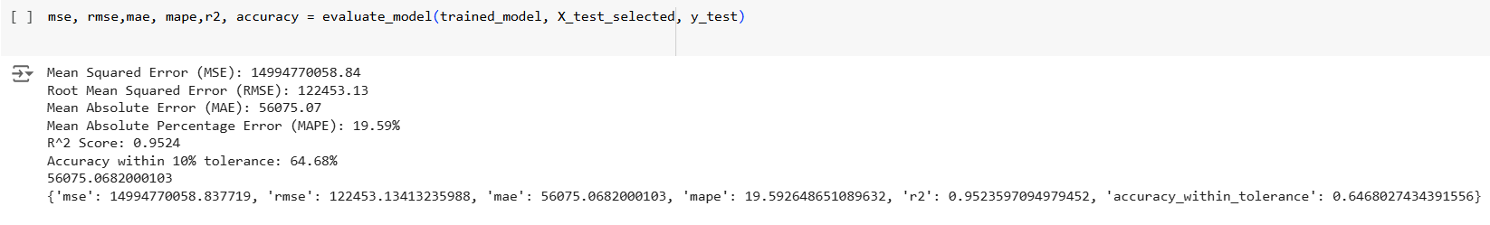
Baseline Model: Our Baseline model was XGBoost and its performance was best due to the feature used “sold price” and error was low with 19%,and we select total of 10 features.

Slide 8
Week 1 Progress - Log key activities and initial findings:
Log file links:
https://drive.google.com/file/d/1fBrvqwatsu3qSAl1djrFPiti_1ao68XZ/view?usp=sharing
https://drive.google.com/file/d/1Q29kq5b49T-a9vny4yDexufCipabZfee/view?usp=sharing

Slide 9
ABOUT THE PROJECT
Week 2 Progress - Log developments in modelling or approach adjustments
Log file links:
https://drive.google.com/file/d/1ke7tySi4LRVktns1CHq6B4qJtC422UF_/view?usp=sharing

Slide 10
Week 3 Progress - Log final implementations and results
Log file links:
https://drive.google.com/file/d/1ke7tySi4LRVktns1CHq6B4qJtC422UF_/view?usp=sharing

Slide 11
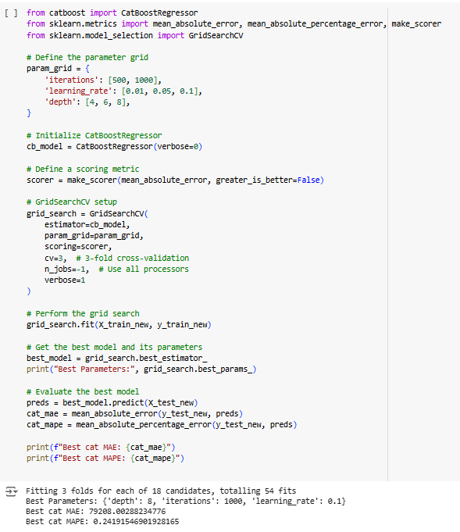
NOW
Evaluation matrices and Results:
Evaluation matrices: We use evaluation matrice MAPE for checking the performance of model and by adjusting the learning rate ,depth and iterations in CatBoost model and we gain the error which was 24% by add the extra features which were best 14 after checking the values of evaluation matrices with different features selection and choose best 14 for further evaluation.
Results: After baseline model application on 10 features and checking model performance we have done feature engineering by selecting best 14 features and further applied 3 models SVC,KNN and CatBoost from which CatBoost was good with less error.

Slide 12
Demo Video Link
https://drive.google.com/file/d/1BbIXbsOek1uVGHvFi6DLw8VoG7TzLDHU/view?usp=sharing
Venus has a beautiful name and is the second planet from the Sun. It’s terribly hot—even hotter than Mercury—and its atmosphere is extremely poisonous. It’s the second-brightest natural object in the night sky after the Moon

Slide 13
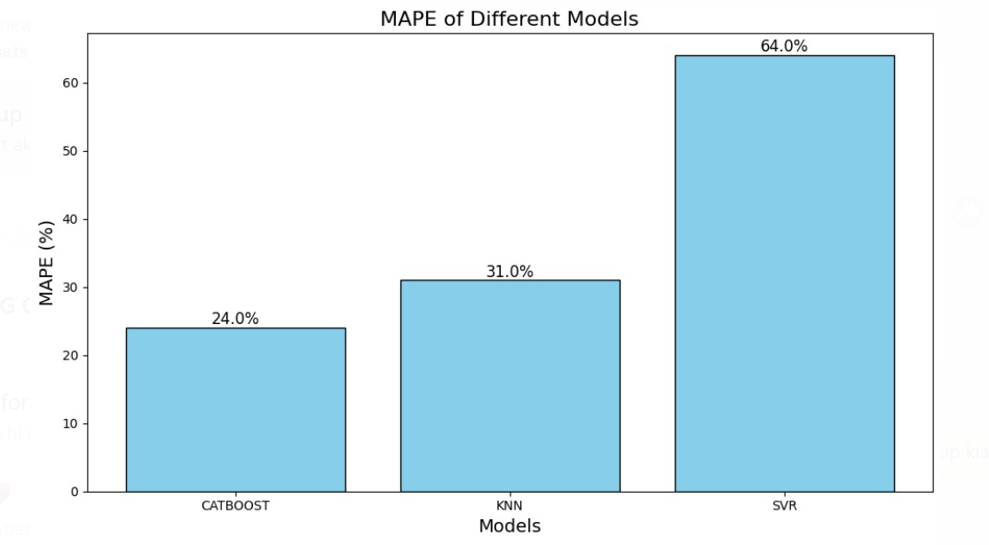
Visualizations and Insights Obtained
Insights: From the whole process we obtained that CatBoost demonstrates superior efficiency for the task, likely due to its ability to handle complex datasets and optimize hyperparameters effectively. So for future predictions, CatBoost would be the preferred choice given its lower absolute percentage error rate.

Slide 14
VENUS
30%
MERCURY
10%
Challenges Faced and Lessons Learned
Challenges one of the primary challenges we encountered during the project was data extraction and the subsequent preprocessing of a large and complex dataset. Handling such a significant volume of data required meticulous attention to detail and a structured approach to ensure the data was clean, meaningful, and ready for modeling.
A specific challenge arose with categorical encoding, particularly for features like "Community" and "Brokerage", which contained an extensive number of unique categories. Encoding these categories directly was impractical due to their sheer number, as it would lead to increased dimensionality and computational complexity.
To address this, we implemented a strategy to group less frequent categories. Categories representing less than 5% of the data were combined under a new label called "Others". This consolidation reduced the number of unique categories significantly, bringing them down to just 23, which made the encoding process much more manageable and efficient.
This approach not only simplified our preprocessing workflow but also ensured that the model could focus on the most relevant and impactful categories, ultimately improving performance and reducing noise in the data. And learned that dataset should be specific and related to prediction EDA(exploratory data analysis) of a big data is very challenging and maintenance of performance is so difficult.

Slide 15
REVENUE LAST YEAR
75
Future Improvements
Future Improvements for the Project: To enhance the performance and usability of this project, we can focus on the following improvements:
Data Enrichment:Dataset should have relevant features (columns) that align with the goals of the analysis. Irrelevant or redundant features can complicate the process.
Advanced Feature Engineering: Use techniques like feature crossing or interaction terms to uncover hidden patterns and relationships in the data.
Deep Learning Models: Explore the application of deep learning architectures, such as neural networks, which can capture complex, non-linear relationships in the data, potentially enhancing predictive performance.
Model Optimization: Implement hyperparameter tuning and ensemble methods like stacking to boost model accuracy and robustness.

Slide 16

References and Open Discussion
Reference of raw sample dataset which we have used:
https://drive.google.com/file/d/1P1ozUvhkkKj3spVcSAmZ-wUJprgligU5/view?usp=sharing
NOW YOU CAN ASK QUESTIONS….

Slide 17
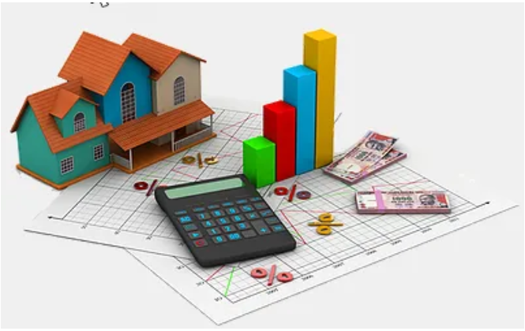
THANK YOU

Slide 18
Mercury is the closest planet to the Sun and the smallest one in the Solar System—it’s only a bit larger than our Moon. The planet’s name has nothing to do with the liquid metal, since it was named after the Roman messenger god, Mercury

